Slide 1
Introduction to PL/SQL, Advanced PL/SQL
Unit -4

Slide 2
TOPIC
• SQL v/s PL/SQL
• PL/SQL Block structure
• Language construct of PL/SQL (Variable, Basic and Composite Data Type, Conditions, Looping etc.)
• %Type and %Rowtype
• Using Cursor (Implicit, Explicit)
• Exception Handling
• Creating and Using Procedure
• Package
• Trigger
• Creating Objects
• Object in Database – Table
• PL/SQL Tables, Nested Tables, Varrays

Slide 3
SQL v/s PL/SQL

Slide 4
SQL v/s PL/SQL
SQL is a Structured Query Language used to issue a single query or execute a single insert/update/delete.
PL/SQL is a procedural language used to create applications.
SQL is used to write queries, DDL and DML statements.
PL/SQL is used to write program blocks, functions, procedures, triggers and packages.

Slide 5
SQL v/s PL/SQL
SQL may be considered as the source of data for our reports, web pages and screens.
PL/SQL can be considered as the application language similar to Java or PHP.
SQL is a data oriented language used to select and manipulate sets of data.
PL/SQL is a procedural language used to create applications.

Slide 6
SQL v/s PL/SQL
SQL is executed one statement at a time.
PL/SQL is executed as a block of code.
SQL can be embedded within a PL/SQL program.
But PL/SQL can’t be embedded within a SQL statement.

Slide 7
PL/SQL BLOCK STRUCTURE

Slide 8
PL/SQL BLOCK STRUCTURE
A PL/SQL block is defined by the keywords DECLARE, BEGIN, EXCEPTION, and END.
These keywords divide the block into a declarative part, an executable part, and an exception-handling part.
The declaration section is optional and may be used to define and initialize constants and variables.
PL/SQL blocks contain three sections
Declare section
Executable section and
Exception-handling section.

Slide 9
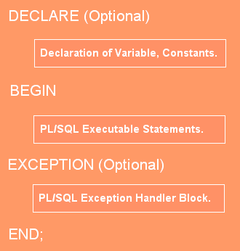

Slide 10
PL/SQL BLOCK STRUCTURE
PL/SQL block has the following structure:
DECLARE
Declaration statements
BEGIN
Executable statements
EXCETION
Exception-handling statements
END ;

Slide 11
Ex. 1 Simaple Program in pl/sql
Declare
begin
dbms_output.put_line('kamani college');
dbms_output.put_line('BCA Department');
end;

Slide 12
EX.2 Format to print massage
DECLARE
BEGIN
DBMS_OUTPUT.PUT_LINE('Start'); -- Prints with newline
DBMS_OUTPUT.PUT('This is '); -- Same line (no newline)
DBMS_OUTPUT.PUT('one line.'); -- Continues same line
DBMS_OUTPUT.NEW_LINE; -- Moves to new line
DBMS_OUTPUT.PUT_LINE('End'); -- Prints with newline
END;
/

Slide 13
🔑 Summary:
PUT_LINE → prints text + newline.
PUT → prints text only (no newline).
NEW_LINE → prints only a newline (blank line).

Slide 14
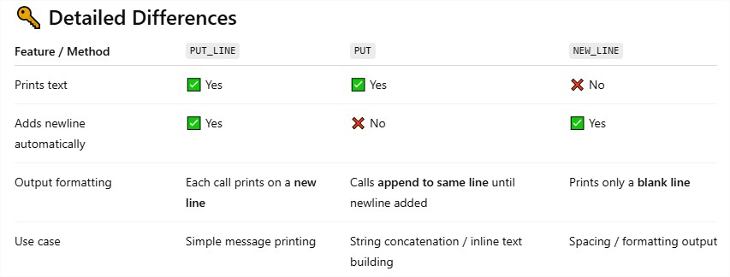

Slide 15
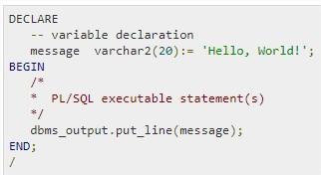
The PL/SQL Comments
The PL/SQL supports single-line and multi-line comments.
All characters available inside any comment are ignored by the PL/SQL compiler.
The PL/SQL single-line comments start with the delimiter -- (double hyphen) and multi-line comments are enclosed by /* and */.

Slide 16
Variable , basic data type, conditions loop

Slide 17
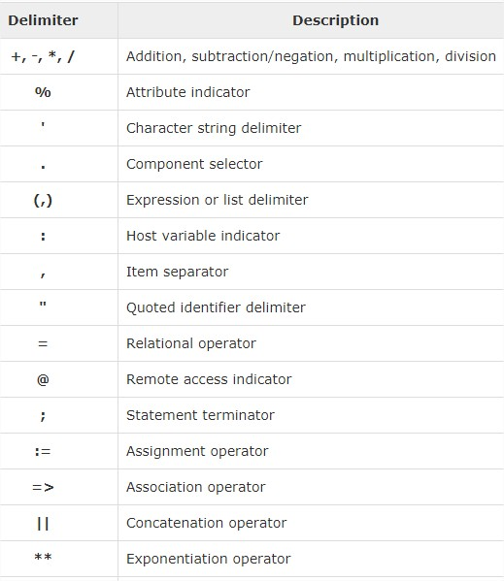
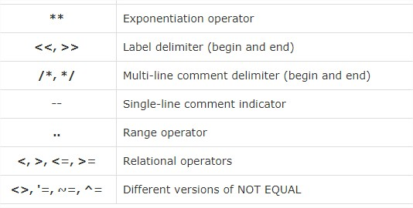
The PL/SQL Delimiters

Slide 18
The PL/SQL Identifiers
PL/SQL identifiers are constants, variables, exceptions, procedures, cursors, and reserved words.
The identifiers consist of a letter optionally followed by more letters, numerals, dollar signs, underscores, and number signs and should not exceed 30 characters.

Slide 19
Initializing Variables in PL/SQL
Whenever you declare a variable, PL/SQL assigns it a default value of NULL.
If you want to initialize a variable with a value other than the NULL value, you can do so during the declaration, using either of the following −
The DEFAULT keyword
The assignment operator (:=)

Slide 20

Ex. 1 The DEFAULT keyword
DECLARE
greetings varchar2(20) DEFAULT 'Have a Good Day ' ;
BEGIN
dbms_output.put_line(greetings);
END;

Slide 21

Ex. 2 The assignment operator (:=)
DECLARE
a integer := 10;
b integer := 20;
c integer;
f real;
BEGIN
c := a + b;
dbms_output.put_line('Value of c: ' || c);
f := 70.0/3.0;
dbms_output.put_line('Value of f: ' || f);
END;

Slide 22
Ex.3 fix values in variable
-- fix values in variable
declare
x number(3);
y number(3);
begin
x:=10;
y:=20;
dbms_output.put_line(x+y);
end;

Slide 23
Ex.4 user define values get
-- user define values get
declare
x number(3);
y number(3);
begin
dbms_output.put_line('Addition of ='||(:x + :y));
dbms_output.put_line('Subtraction of ='||(:x - :y));
dbms_output.put_line('Multiplication of ='||(:x * :y));
dbms_output.put_line('Division of ='||(:x / :y));
end;

Slide 24
Variable Scope in PL/SQL

Slide 25
Variable Scope in PL/SQL
PL/SQL allows the nesting of blocks, i.e., each program block may contain another inner block.
If a variable is declared within an inner block, it is not accessible to the outer block.
However, if a variable is declared and accessible to an outer block, it is also accessible to all nested inner blocks.
There are two types of variable scope
Local variables − Variables declared in an inner block and not accessible to outer blocks.
Global variables − Variables declared in the outer most block or a package.

Slide 26
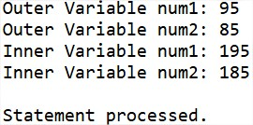
Ex.
DECLARE
-- Global variables
num1 number := 95;
num2 number := 85;
BEGIN
dbms_output.put_line('Outer Variable num1: ' || num1);
dbms_output.put_line('Outer Variable num2: ' || num2);
DECLARE
-- Local variables
num1 number := 195;
num2 number := 185;
BEGIN
dbms_output.put_line('Inner Variable num1: ' || num1);
dbms_output.put_line('Inner Variable num2: ' || num2);
END;
END;

Slide 27
PL/SQL-Constants and Literals

Slide 28
PL/SQL-Constants and Literals
A constant holds a value that once declared, does not change in the program.
A constant declaration specifies its name, data type, and value, and allocates storage for it.
The declaration can also impose the NOT NULL constraint.
Declaring a Constant
A constant is declared using the CONSTANT keyword.

Slide 29

Ex.-1 PL/SQL-Constants
DECLARE
college_name constant varchar2(20) := 'SY BCA';
BEGIN
dbms_output.put_line('I study in '|| college_name);
END;

Slide 30
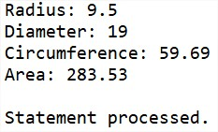
EX.-2 PL/SQL-Constants
DECLARE
-- constant declaration
pi constant number := 3.141592654;
-- other declarations
radius number(5,2);
dia number(5,2);
circumference number(7, 2);
area number (10, 2);
BEGIN
-- processing
radius := 9.5;
dia := radius * 2;
circumference := 2.0 * pi * radius;
area := pi * radius * radius;
-- output
dbms_output.put_line('Radius: ' || radius);
dbms_output.put_line('Diameter: ' || dia);
dbms_output.put_line('Circumference: ' || circumference);
dbms_output.put_line('Area: ' || area);
END;

Slide 31
The PL/SQL Literals

Slide 32
The PL/SQL Literals
A literal is an explicit numeric, character, string, or Boolean value not represented by an identifier.
For example, TRUE, 786, NULL, 'tutorialspoint' are all literals of type Boolean, number, or string.
PL/SQL,literals are case-sensitive.
PL/SQL supports the following kinds of literals −
Numeric Literals
Character Literals
String Literals
BOOLEAN Literals
Date and Time Literals

Slide 33
Ex.
DECLARE
message varchar2(30):= 'That''s tutorialspoint.com!';
str varchar2(30):= 'Welcome to Studytonight.com';
BEGIN
dbms_output.put_line(message);
dbms_output.put_line(str);
END;

Slide 34
PL/SQL-Operators

Slide 35
PL/SQL-Operators
An operator is a symbol that tells the compiler to perform specific mathematical or logical manipulation.
PL/SQL language is rich in built-in operators and provides the following types of operators −
Arithmetic operators- Addition, Subtraction, Multiplication, Division
Relational operators - Less then, Greater Than, etc.
Comparison operators- Like ,Between, In, IsNull
Logical operators- AND, OR, NOT
String operators-

Slide 36
Ex. Arithmetic operation
-- Arithmetic operation user define values get
declare
x number(3);
y number(3);
begin
dbms_output.put_line('Addition of ='||(:x + :y));
dbms_output.put_line('Subtraction of ='||(:x - :y));
dbms_output.put_line('Multiplication of ='||(:x * :y));
dbms_output.put_line('Division of ='||(:x / :y));
end;

Slide 37
PL/SQL Tables

Slide 38
PL/SQL WITH TABLE
create table emp(id number (3),name varchar2(10), salary number(10));
insert into emp values(1,'Hetansh',4000)
select *from emp
alter table emp ADD (sal_update number(10))
EX.
declare
X number(3):=2;
begin
INSERT into emp values(2,'Sagar',3000,'');
UPDATE emp set sal_update = salary * X where id=1;
--DELETE from emp where id=1;
END;

Slide 39
PL/SQL basic Data Types

Slide 40
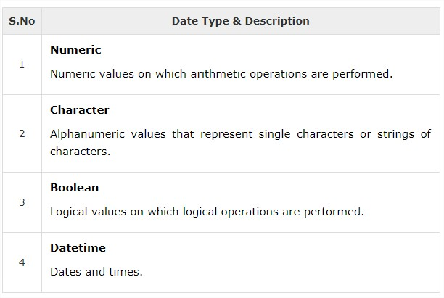
PL/SQL basic Data Types

Slide 41
Control structure

Slide 42
Three type of control structure
[1]Conditional Control
1) IF…THEN…END IF
2) IF…THEN..ELSE…END IF
3) IF…THEN…ELSIF…END IF
4) CASE…ENDCASE
5) Nested IF-THEN-ELSE
[2] Iterative Control /Looping structure
[1]Basic LOOP
[2]FOR..LOOP
[3]WHILE FOR…LOOP
[3]Sequential Control
[1]GOTO Statement

Slide 43
Conditional control
PL/SQL allows the use of an IF statement to control the execution of a block of code.
PL/SQL has four conditional or selection statement available for decision making:
1) IF…THEN…END IF
2) IF…THEN..ELSE…END IF
3) IF…THEN…ELSIF…END IF
4) CASE…ENDCASE

Slide 44
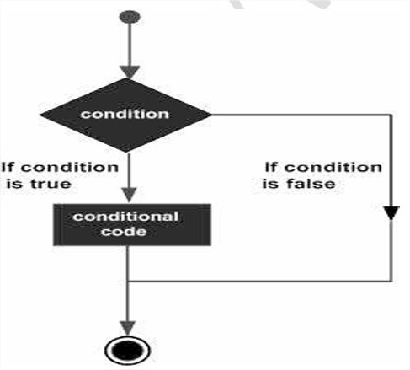
1) IF…THEN…END IF
A simple IF statement performs action statement if the result of the condition is TRUE.
If the condition is FALSE no action is performed , and the program continues with the next statement in the block.
Syntax:
If <condition>THEN
<action>
END IF

Slide 45

EXAMPLE :
DECLARE
a number(2) := 10;
BEGIN
a:= 10;
-- check the boolean condition using if statement
IF( a < 20 ) THEN
-- if condition is true then print the following
dbms_output.put_line('a is less than 20 ' );
END IF;
dbms_output.put_line('value of a is : ' || a);
END;
/

Slide 46
2) IF…THEN..ELSE…END IF
It is an extension of the simple IF statement .
It provides action statement for the TRUE outcome as well as for the FALSE outcome.
Syntax:
If <condition>THEN
<action>
ELSE
<some other action>;
END IF;

Slide 47
EXAMPLE: 1
declare
no number(3);
begin
no:=20;
if (no < 70)then
dbms_output.put_line('smaller');
else
dbms_output.put_line('bigest');
end if;
End;
/

Slide 48

EXAMPLE: 2
DECLARE
a number(3) := 100;
BEGIN
-- check the boolean condition using if statement
IF( a < 20 ) THEN
-- if condition is true then print the following
dbms_output.put_line('a is less than 20 ');
ELSE
dbms_output.put_line('a is not less than 20 ');
END IF;
dbms_output.put_line('value of a is : ' || a);
END;

Slide 49
3) IF…THEN…ELSIF…END IF
It is an extension to the previous statement .
When you have many alternatives/option, you can use previously explained statement but the ELSIF alternative is more efficient than the other two.
Syntax:
If <condition>THEN
<action>
ELSIF<condition Action>THEN
<some other action>
ELSE
<some other action>;
END IF;

Slide 50
Example : 1
declare
x number(3);
y number(3);
begin
x:=200;
y:=100;
if (x=y) then
dbms_output.put_line('equal');
elsif (x > y)then
dbms_output.put_line('bigest');
else
dbms_output.put_line('smaller');
end if;
end;
/

Slide 51

Example : 2
DECLARE
v_number NUMBER := 10; -- Declare a variable
BEGIN
-- Conditional statement
IF v_number > 0 THEN
DBMS_OUTPUT.PUT_LINE('The number is positive.');
ELSIF v_number < 0 THEN
DBMS_OUTPUT.PUT_LINE('The number is negative.');
ELSE
DBMS_OUTPUT.PUT_LINE('The number is zero.');
END IF;
END;
/

Slide 52

Example : 3
DECLARE
a number(3) := 100;
BEGIN
IF ( a = 10 ) THEN
dbms_output.put_line('Value of a is 10' );
ELSIF ( a = 20 ) THEN
dbms_output.put_line('Value of a is 20' );
ELSIF ( a = 30 ) THEN
dbms_output.put_line('Value of a is 30' );
ELSE
dbms_output.put_line('None of the values is matching');
END IF;
dbms_output.put_line('Exact value of a is: '|| a );
END;
/

Slide 53

Example : 4
DECLARE
v_score NUMBER := 85; -- Example score
v_grade CHAR(1); -- Variable to hold the grade
BEGIN
IF v_score >= 90 THEN
v_grade := 'A';
ELSIF v_score >= 80 THEN
v_grade := 'B';
ELSIF v_score >= 70 THEN
v_grade := 'C';
ELSIF v_score >= 60 THEN
v_grade := 'D';
ELSE
v_grade := 'F';
END IF;
DBMS_OUTPUT.PUT_LINE('The grade is: ' || v_grade);
END;

Slide 54
[4] CASE…ENDCASE
Like the IF statement, the CASE statement selects one sequence of statements to execute.
However, to select the sequence, the CASE statement uses a selector rather than multiple Boolean expressions
Syntax
CASE selector
WHEN 'value1' THEN S1;
WHEN 'value2' THEN S2;
WHEN 'value3' THEN S3;
...
ELSE Sn; -- default case
END CASE;

Slide 55
EX.
DECLARE
grade char(1) := 'B';
BEGIN
CASE grade
when 'A' then dbms_output.put_line('Excellent');
when 'B' then dbms_output.put_line('Very good');
when 'C' then dbms_output.put_line('Well done');
when 'D' then dbms_output.put_line('You passed');
when 'F' then dbms_output.put_line('Better try again');
else
dbms_output.put_line('No such grade');
END CASE;
END;
/

Slide 56
[5] Nested IF-THEN-ELSE
It is always legal in PL/SQL programming to nest the IF-ELSE statements, which means you can use one IF or ELSE IF statement inside another IF or ELSE IF statement(s).
Syntax
IF( boolean_expression 1)THEN
-- executes when the boolean expression 1 is true
IF(boolean_expression 2) THEN
-- executes when the boolean expression 2 is true
sequence-of-statements;
END IF;
ELSE
-- executes when the boolean expression 1 is not true
else-statements;
END IF;

Slide 57
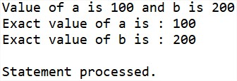
Ex.
DECLARE
a number(3) := 100;
b number(3) := 200;
BEGIN
-- check the boolean condition
IF( a = 100 ) THEN
-- if condition is true then check the following
IF( b = 200 ) THEN
-- if condition is true then print the following
dbms_output.put_line('Value of a is 100 and b is 200' );
END IF;
END IF;
dbms_output.put_line('Exact value of a is : ' || a );
dbms_output.put_line('Exact value of b is : ' || b );
END;
/

Slide 58
Iterative Control & looping structure

Slide 59
Iterative control
Iterative control statement perform one or more statements repeatedly , either a certain number of times or until a condition is meet. There three forms of iterative structures:
1)Basic Loop.
2)While..Loop.
3)For..Loop.

Slide 60
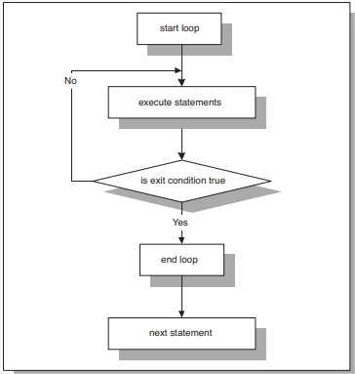
1)Basic Loop.
A basic loop is a loop that is performed repeatedly. once a loop is entered all statement in the loop are performed.
Syntax:
Loop
<statement>
Exit [when <condition>];
Increment statement;
END LOOP

Slide 61
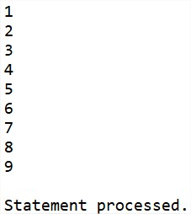
Ex.
declare
i number(3):=1;
begin
loop
exit when(i>=10);
dbms_output.put_line(i);
i:=i+1;
end loop;
end;
/

Slide 62
2)While…Loop.
While loop has a condition associated with the loop.
The condition is evaluated and if the condition is true the statement inside the loop are executed.
Ex.
While<condition>
Loop
<loop body statement>
Increment statement;
End loop

Slide 63
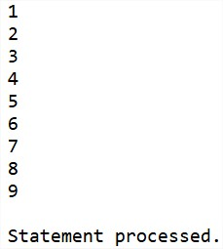
Ex.
declare
i number(3):=1;
begin
while(i<10)
loop
dbms_output.put_line(i);
i:=i+1;
end loop;
end;
/

Slide 64
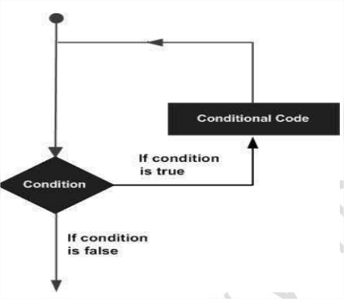
3)For..Loop.
We use FOR..LOOP if we want the iterations to occur a fixed number of times. The FOR..LOOP is executed for a range values.
Syntax:
For<variable>IN <start range>..<end range>
Loop
<loop body statement>
End loop;

Slide 65
Ex…(1)
DECLARE
i number(1);
BEGIN
-- outer_loop
FOR i IN 1..3 LOOP
dbms_output.put_line('i is: '|| i );
END loop ;
END;
/

Slide 66
Ex…(2)
DECLARE
i number(1);
j number(1);
BEGIN
-- outer_loop
FOR i IN 1..3 LOOP
-- inner_loop
FOR j IN 1..3 LOOP
dbms_output.put_line('i is: '|| i || ' and j is: ' || j);
END loop ;
END loop ;
END;
/

Slide 67
EX. (3)
declare
i number(3):=1;
begin
i:=100;
for i in reverse 5..10
loop
dbms_output.put_line(i);
end loop;
end;
/

Slide 68
Sequential Control

Slide 69
Sequential Control GOTO statement
A GOTO statement with a label may be used to pass control to another part of the program.
👉 Note: Using GOTO is not recommended in PL/SQL unless absolutely necessary (it makes the program harder to read and maintain).
Syntax.
GOTO label; ... ... << label >> statement;
label: This is the name of the label to which control will be transferred. Labels are defined within double angle brackets (<< >>).

Slide 70
Ex.
declare
x number(3):=10;
begin
loop
x:=x+3;
if x > 20 then
goto stop;
end if;
end loop;
<<stop>>
dbms_output.put_line('OUTSIDE LOOP...');
end;
/

Slide 71
Execution Flow:
x := 10
Enter the infinite LOOP
Iteration 1 → x = 13 (not > 20, continue loop)
Iteration 2 → x = 16 (not > 20, continue loop)
Iteration 3 → x = 19 (not > 20, continue loop)
Iteration 4 → x = 22 (> 20 → GOTO stop)
Control jumps to the label <<stop>>.
Prints:
OUTSIDE LOOP...
Program ends successfully.

Slide 72
Program in pl/sql

Slide 73
Pro-1 next values generate.
DECLARE
x number := 10;
BEGIN
LOOP
dbms_output.put_line(x);
x := x + 10;
IF x > 50 THEN
exit;
END IF;
END LOOP;
-- after exit, control resumes here
dbms_output.put_line('After Exit x is: ' || x);
END;
/

Slide 74
O /p :
10
20
30
40
50
After Exit x is: 60 Statement processed.

Slide 75
Pro-2 factorial program
declare
i number(4):=1;
n number(4):=5;
f number(4):=1;
begin
for i in 1..n
loop
f:=f*i;
Dbms_output.put_line('The factorial of '||i||' is:'||f);
end loop;
end;
/

Slide 76
Output :
The factorial of 1 is:1
The factorial of 2 is:2
The factorial of 3 is:6
The factorial of 4 is:24
The factorial of 5 is:120
Statement processed.

Slide 77
Pro.-3 Odd even number
Declare
BEGIN
for i in 1..10
loop
if mod(i,2) = 0 then
dbms_output.put_line(i||' is an even number');
else
dbms_output.put_line(i||' is an odd number');
end if;
end loop;
END;
/

Slide 78
1 is an odd number
2 is an even number
3 is an odd number
4 is an even number
5 is an odd number
6 is an even number
………..
…….....
………..
10 is an even number
Statement processed.

Slide 79
Pro-4 block to generate Fibonacci series.
declare
a number:= 0;
b number:= 1;
c number;
begin
dbms_output.put_line(a||' ');
dbms_output.put_line(b||' ');
for i in 3..10
loop
c := a + b;
dbms_output.put_line(c||' ');
a := b;
b := c;
end loop;
end;

Slide 80
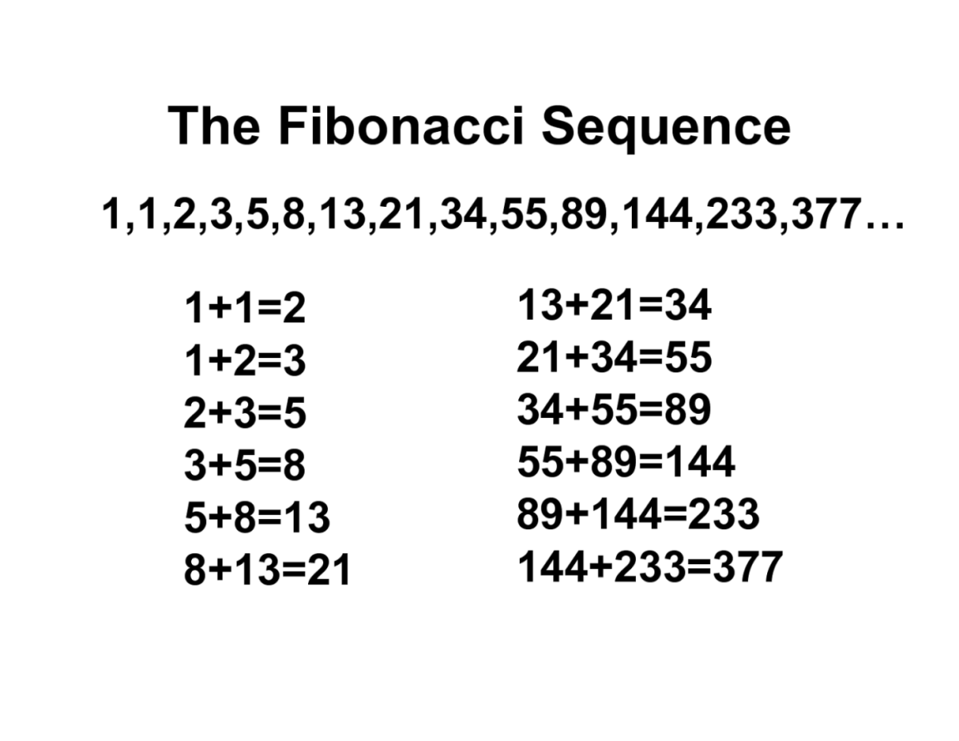
Output:
0 1 1 2 3 5 8 13 21 34
PL/SQL procedure successfully completed

Slide 81
Pro-5 find sum and average of three numbers.
declare
a number:=1;
b number:=2;
c number:=3;
sm number;
av number;
begin
sm:=a+b+c;
av:=sm/3;
dbms_output.put_line('Sum = '||sm);
dbms_output.put_line('Average = '||av);
end;
/

Slide 82
Output :
Sum = 6
Average = 2
PL/SQL procedure successfully completed.

Slide 83
Pro.6 find reverse of a number
declare
N number;
S NUMBER := 0;
R NUMBER;
K number;
begin
N := 1234;
K := N;
loop
exit WHEN N = 0;
S := S * 10;
R := MOD(N,10);
S := S + R;
N := TRUNC(N/10);
end loop;
dbms_output.put_line('THE REVERSED DIGITS OF '||K||' = '||S);
End;

Slide 84
Output :
THE REVERSED DIGITS OF 1234 = 4321
Statement processed.

Slide 85
Ex.2 REVERSED number
declare
i number(3);
begin
dbms_output.put_line('THE REVERSED DIGITS OF 5 6 7 8 9 10 is ');
for i in reverse 5..10
loop
dbms_output.put_line(i);
end loop;
end;
/

Slide 86
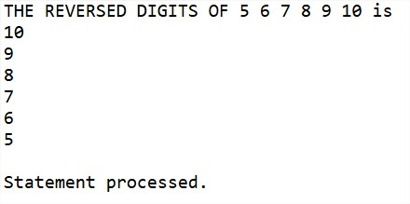

Slide 87
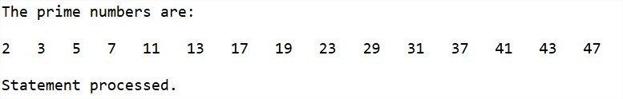
Prime number
DECLARE
i NUMBER(3);
j NUMBER(3);
BEGIN
dbms_output.Put_line('The prime numbers are:');
dbms_output.new_line;
i := 2;
LOOP
j := 2;
LOOP
EXIT WHEN( ( MOD(i, j) = 0 )
OR ( j = i ) );
j := j + 1;
END LOOP;
IF( j = i )THEN
dbms_output.Put(i||' ');
END IF;
i := i + 1;
exit WHEN i = 50;
END LOOP;
dbms_output.new_line;
END;
/

Slide 88
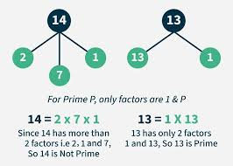
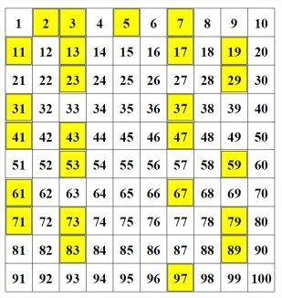
Prime number

Slide 89
Armstrong number
declare
n number:=407;
s number:=0;
r number;
len number;
m number;
begin
m:=n;
len:=length(to_char(n));
while n>0
loop
r:=mod(n,10);
s:=s+power(r,len);
n:=trunc(n/10);
end loop;
if m=s
then
dbms_output.put_line('armstrong number');
else
dbms_output.put_line('not armstrong number');
end if;
end;

Slide 90
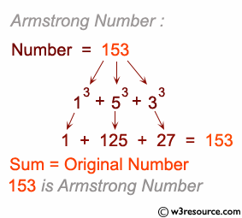
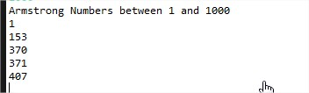
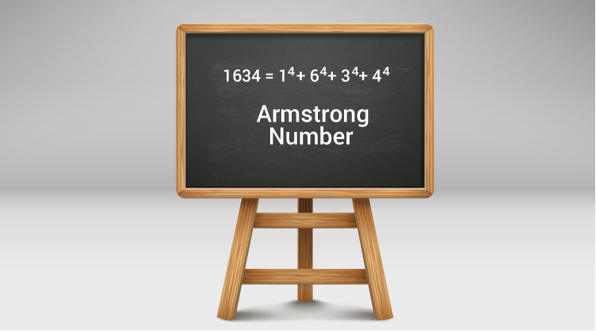
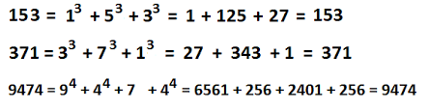
Armstrong number

Slide 91
Palindrome Number in PL/SQL
declare
num number := 12321; -- Change this to test
temp number;
rev number := 0;
digit number;
begin
temp := num;
while temp > 0 loop
digit := mod(temp, 10); -- get last digit
rev := (rev * 10) + digit; -- build reverse number
temp := trunc(temp / 10); -- remove last digit
end loop;
if rev = num then
dbms_output.put_line(num || ' is a Palindrome Number');
else
dbms_output.put_line(num || ' is Not a Palindrome Number');
end if;
end;
/

Slide 92
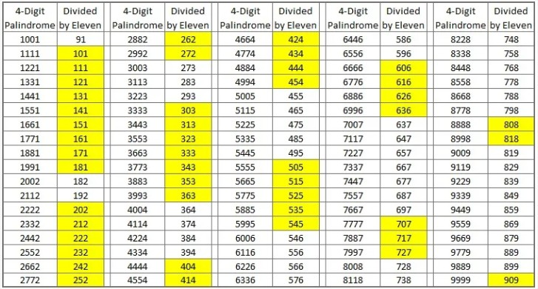
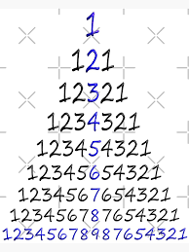
1234321 is a Palindrome Number
Statement processed.

Slide 93
Reverse a String in PL/SQL
DECLARE
original_str VARCHAR2(100) := 'Hello, World!';
reversed_str VARCHAR2(100) := '';
BEGIN
FOR i IN REVERSE 1 .. LENGTH(original_str) LOOP
reversed_str := (reversed_str || SUBSTR(original_str, i, 1));
DBMS_OUTPUT.PUT_LINE('Reversed String: ' || reversed_str);
END LOOP;
DBMS_OUTPUT.PUT_LINE('Original String: ' || original_str);
DBMS_OUTPUT.PUT_LINE('Reversed String: ' || reversed_str);
END;
/

Slide 94
📝 Explanation:
original_str is the string you want to reverse.
FOR i IN REVERSE loops backward from the end of the string.
SUBSTR(original_str, i, 1) gets each character from the end.
DBMS_OUTPUT.PUT_LINE prints the result.
Output :
Original String: Hello, World!
Reversed String: !dlroW ,olleH.
Statement processed.

Slide 95
Write a PL/SQL program to find the sum of digits of a given number.
DECLARE
v_num NUMBER := 9875; -- Input number
v_sum NUMBER := 0; -- To store sum of digits
v_rem NUMBER; -- To hold remainder (digit)
BEGIN
WHILE v_num > 0 LOOP
v_rem := MOD(v_num, 10); -- Get last digit
v_sum := v_sum + v_rem; -- Add to sum
v_num := TRUNC(v_num / 10); -- Remove last digit
END LOOP;
DBMS_OUTPUT.PUT_LINE('Sum of digits = ' || v_sum);
END;
/

Slide 96
For 9875 → 9 + 8 + 7 + 5 = 29
Sum of digits = 29

Slide 97
Advanced PL/SQL

Slide 98
PL/SQL– Arrays

Slide 99
PL/SQL– VArrays
The PL/SQL programming language provides a data structure called the VARRAY.
which can store a fixed-size sequential collection of elements of the same type.
A varray is used to store an ordered collection of data, however it is often better to think of an array as a collection of variables of the same type.
All varrays consist of contiguous memory locations.

Slide 100
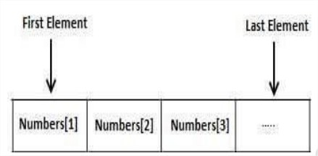
The lowest address corresponds to the first element and the highest address to the last element.

Slide 101
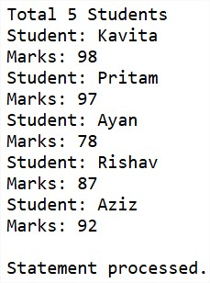
Ex.
DECLARE
type namesarray IS VARRAY(5) OF VARCHAR2(10);
type grades IS VARRAY(5) OF INTEGER;
names namesarray;
marks grades;
total integer;
BEGIN
names := namesarray('Kavita', 'Pritam', 'Ayan', 'Rishav', 'Aziz');
marks:= grades(98, 97, 78, 87, 92);
total := names.count;
dbms_output.put_line('Total '|| total || ' Students');
FOR i in 1 .. total LOOP
dbms_output.put_line('Student: ' || names(i) || '
Marks: ' || marks(i));
END LOOP;
END;

Slide 102
% TYPE and % ROWTYPE

Slide 103
% TYPE
→ Used to declare a variable with the same data type as a table column or another variable.
→ %TYPE is used to declare a field with the same type as that of a specified table's column:
→This is particularly useful when you want to ensure that your variable matches the column's data type.
Syntax:
variable_name table_name.column_name%TYPE;

Slide 104
Ex. 1
declare
no emp.id %type;
nm emp.name %type;
sal emp.salary %type;
begin
select id,name,salary into no,nm,sal from emp WHERE ROWNUM = 1;
dbms_output.put_line(no);
dbms_output.put_line(nm);
dbms_output.put_line(sal);
end;
/

Slide 105
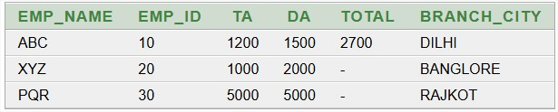
Ex. 2
create table type (emp_name varchar(10),emp_id number(10),TA number(10),DA number(10),total number(10),branch_city varchar(10))
insert into type values('ABC',10,1200,1500,2700,'DILHI');
insert into type values('XYZ',20,1000,2000,NULL,'BANGLORE');
insert into type values('PQR',30,5000,5000,NULL,'RAJKOT');
select *from type

Slide 106
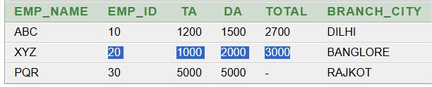
Ex. 2 conti….. %type
declare
a type.TA %type;
b type.DA %type;
t type.total %type;
begin
select TA,DA into a,b from type where emp_id=20;
t:= a+b;
update type set total=t where emp_id=20;
end;

Slide 107
%ROWTYPE
→%ROWTYPE has all properties of %TYPE and one additional what we required only one variable to access any number of columns.
→ %ROWTYPE is used to declare a record with the same types as found in the specified database table, view or cursor:
→This is useful when you want to work with multiple columns from a table without declaring each column individually.
Syntax:
variable_name table_name%ROWTYPE;

Slide 108
Ex.1
declare
myr emp %rowtype;
begin
select * into myr from emp WHERE ROWNUM = 1;
dbms_output.put_line('id is:'||myr.id);
dbms_output.put_line('name is:'||myr.name);
dbms_output.put_line('salary is:'||myr.salary);
end;
/

Slide 109
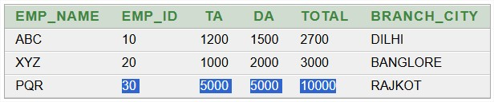
Ex.2 %rowtype
declare
record type%ROWTYPE;
begin
select * into record from type where emp_id=30;
record.total:=record.TA + record.DA;
update type set total=record.total where emp_id=30;
end;

Slide 110
Cursor

Slide 111
Using Cursor (Implicit, Explicit)

Slide 112
What is cursor ?
The oracle engine uses a work area for its internal processing in order to execute an SQL statement. This work area is call CURSOR.
You cannot use a SELECT INTO statement when the query returns/retrieve more than one row.
Cursors are pointer to a memory area that maintain information returned from the query.
The data stored in the cursor memory is call the ‘ACTIVE DATA SET’.

Slide 113
Types of cursor
(1)implicit cursor (SQL cursor :open and managed by oracle)
(2)Explicit cursor (user defined cursor : open and managed by user)

Slide 114
(1)implicit cursor
It is a SQL cursor :open and managed by oracle engine internally.
Implicit cursor using SELECT statement returning one row of data.
The SQL cursor/implicit cursor four attributes:
SQL%found
SQL%notfound
SQL%rowcount
SQL%ISOPEN

Slide 115
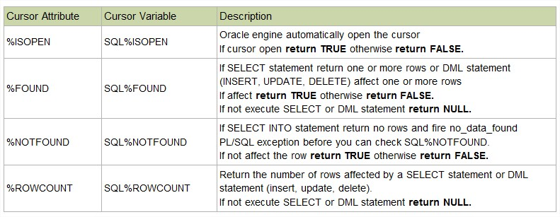

Slide 116
Example (IMPlicit cursor)
declare
aa emp%rowtype;
cursor c1 is select *from emp;
begin
open c1;
if c1%found then
dbms_output.put_line('cursor is open');
else
dbms_output.put_line('cursor is close');
end if;
end;
o/p:
cursor is close
Statement processed.

Slide 117
Ex.1 Implicit cursor (%FOUND ,%NOTFOUND)
--Write a PL/SQL block to display message that whether a record is updated or not.
Declare
begin
update type set branch_city='JUNAGADH' where emp_id=40;
if SQL%FOUND then
dbms_output.put_line('record updated');
end if;
if SQL%NOTFOUND then
dbms_output.put_line('record not updated');
end if;
end;

Slide 118
Ex.2 %ROWCOUNT
declare
num number(2);
begin
update type set TA=1500 where TA>1600;
num:=SQL%ROWCOUNT;
dbms_output.put_line('total rows affected =' ||num);
end;

Slide 119
ex.3 sql%rowcount
DECLARE
total_rows number(2);
BEGIN
UPDATE emp SET salary = salary + 500;
IF sql%notfound THEN
dbms_output.put_line('no employee selected');
ELSIF sql%found THEN
total_rows := sql%rowcount;
dbms_output.put_line( total_rows || ' employee selected ');
END IF;
END;
/

Slide 120
(2)Explicit cursor
Explicit Cursor which are construct/manage by user itself call explicit cursor.
For queries that return multiple rows , you have to explicitly create a cursor.
Four action can be perform on explicit cursor:
Declare the cursor
Open the cursor
Fetch the data from cursor
Close the cursor

Slide 121
Example (Explicit cursor)
declare
e_nm emp.name%type;
e_sl emp.salary%type;
cursor c1 is select name,salary from emp;
begin
open c1;
fetch c1 into e_nm,e_sl;
dbms_output.put_line('salary of '|| e_nm ||' is '||e_sl);
fetch c1 into e_nm,e_sl;
dbms_output.put_line('salary of '|| e_nm ||' is '||e_sl);
fetch c1 into e_nm,e_sl;
dbms_output.put_line('salary of '|| e_nm ||' is '||e_sl);
end;
O/p: salary of aaa is 3000
salary of bbb is 2000
salary of bbb is 5000
is Statement processed.

Slide 122
Exception Handling

Slide 123
Exception handling in pl/sql
An exception is an error condition during a program execution.
PL/SQL supports programmers to catch such conditions using EXCEPTION block in the program and an appropriate action is taken against the error condition.
There are two types of exceptions
System-defined exceptions
User-defined exceptions

Slide 124
syntax
DECLARE
-- Declarations (variables, constants, cursors, etc.)
BEGIN
-- Executable statements
EXCEPTION
-- Exception handling section
WHEN exception_name THEN
-- Statements to handle the error
WHEN OTHERS THEN
-- Handle all other exceptions
END;
/

Slide 125
🔹 Types of Exceptions in PL/SQL
PL/SQL provides three categories of exceptions:
1. Predefined Exceptions
Oracle provides many built-in exceptions.
Example: NO_DATA_FOUND, ZERO_DIVIDE, TOO_MANY_ROWS, INVALID_NUMBER, etc.
These are automatically raised by Oracle.
2. Non-Predefined Exceptions
Oracle has many exceptions that are not automatically declared in PL/SQL.
They must be declared explicitly using EXCEPTION keyword and linked with error code using PRAGMA EXCEPTION_INIT.
3. User-Defined Exceptions
Developers can define their own exceptions and raise them using RAISE.

Slide 126
🔹 Predefined Exception Example
DECLARE
v_result NUMBER;
BEGIN
v_result := 10 / 0; -- Will cause ZERO_DIVIDE exception
DBMS_OUTPUT.PUT_LINE('Result: ' || v_result);
EXCEPTION
WHEN ZERO_DIVIDE THEN
DBMS_OUTPUT.PUT_LINE('Error: Division by zero is not allowed.');
END;
/
✅ Output: Error: Division by zero is not allowed.

Slide 127
🔹 User-Defined Exception Example
DECLARE
insufficient_balance EXCEPTION;
v_balance NUMBER := 500;
v_withdraw NUMBER := 1000;
BEGIN
IF v_withdraw > v_balance THEN
RAISE insufficient_balance; -- Raise user-defined exception
ELSE
v_balance := v_balance - v_withdraw;
END IF;
DBMS_OUTPUT.PUT_LINE('Remaining Balance: ' || v_balance);
EXCEPTION
WHEN insufficient_balance THEN
DBMS_OUTPUT.PUT_LINE('Error: Withdrawal amount exceeds balance.');
END;
/
✅ Output: Error: Withdrawal amount exceeds balance.

Slide 128
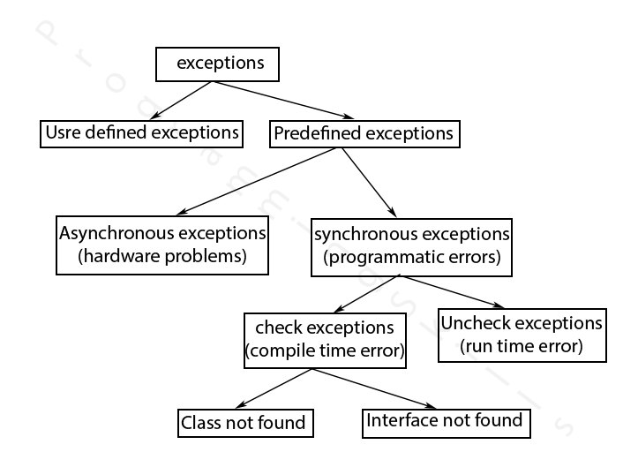

Slide 129
EX. EXCEPTION HANDLING
declare
e_name emp.name%type;
e_salary emp.salary%type;
begin
select name into e_name from emp;
exception
when no_data_found then
dbms_output.put_line('record does not exits');
when too_many_rows then
dbms_output.put_line('multiple rows retrieved');
when others then
dbms_output.put_line('errors in retrieval');
end;

